Slide 1

Public Mental Health Insights
Dashboard about depression done using Power BI.
- Daniel Kirubakaran P

Slide 2

Executive Summary:
Develop interactive dashboards using Tableau/Power BI to enhance data-driven decision-making for public health initiatives, focusing on population health, behavioural risk factors, and mental well-being.

Slide 3
Methodology:
1. Data Integration: Combine demographic, behavioural, and health data from internal and external sources.
2. Dashboard Design: Collaborate with stakeholders to design visually appealing dashboards.
3. Interactivity: Implement drill-down features for detailed analysis.

Slide 4
Expected Outcomes:
- Real-time insights into population health trends and risk factors
- Enhanced decision-making for public health initiatives
- Improved collaboration among healthcare professionals and researchers

Slide 5
Proposed Dashboards:
1. Population Overview
2. Behavioural Risk Factors
3. Mental Health and Well-being
4. Chronic Medical Conditions
5. Health Trends and Insights

Slide 6
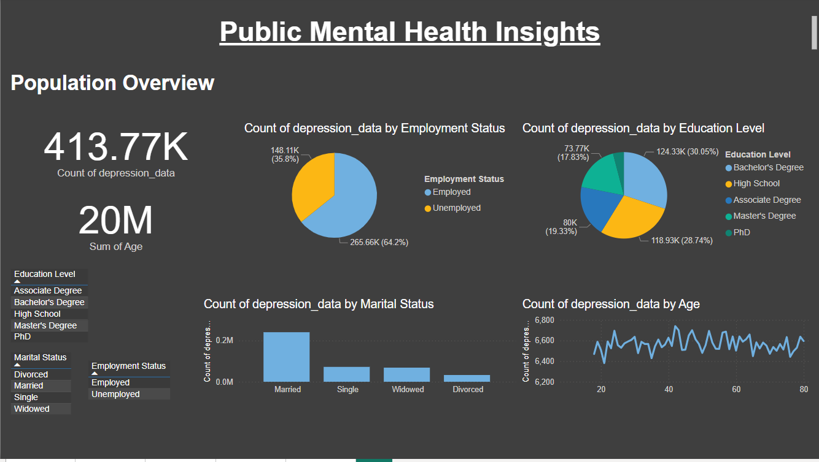

Slide 7
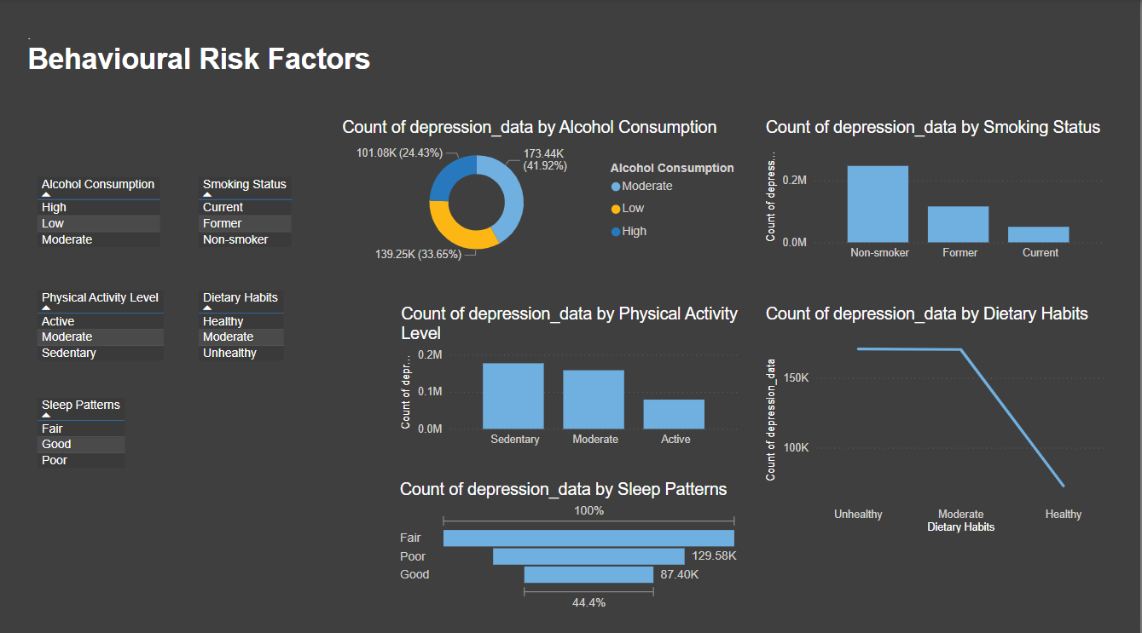

Slide 8
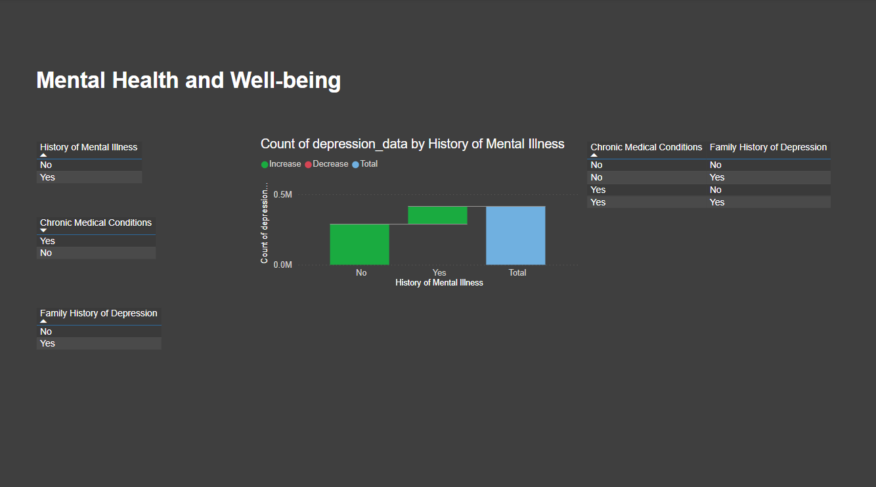

Slide 9
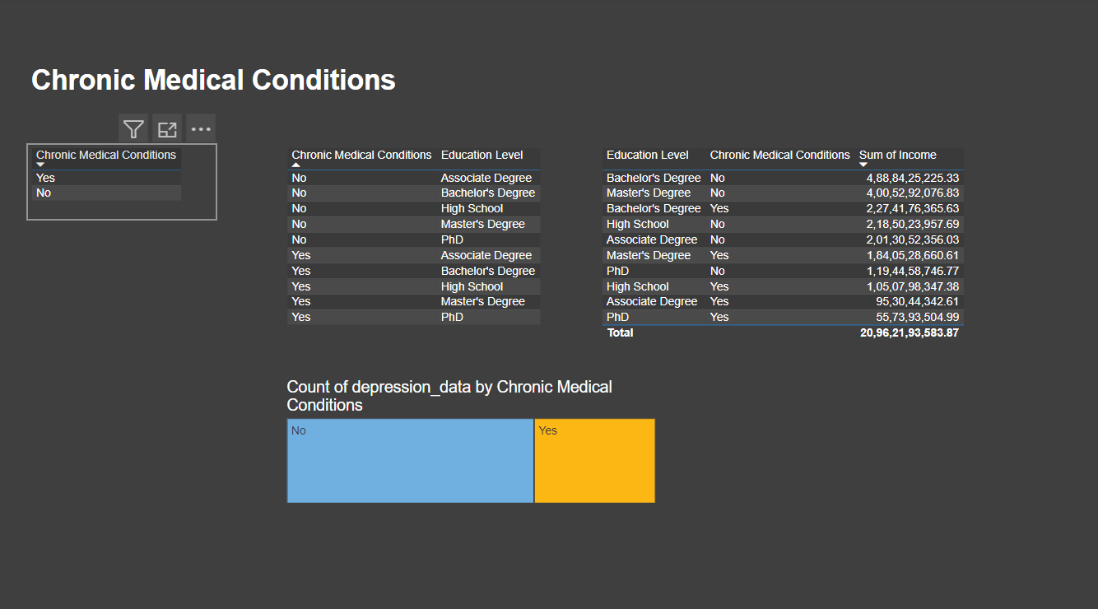

Slide 10
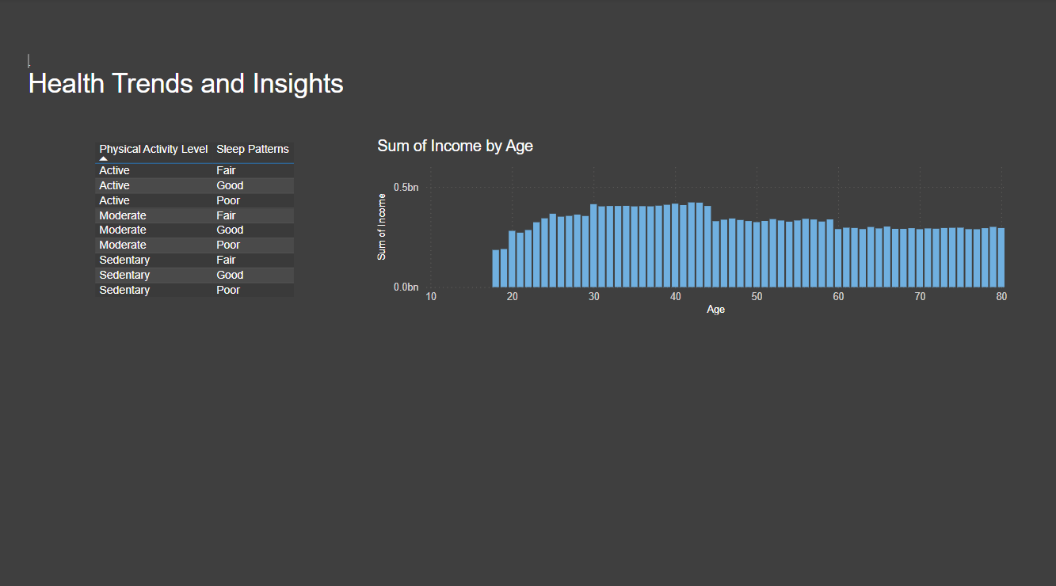

Slide 11
Conclusion:
The Public Health Insights Dashboard project will empower healthcare professionals and researchers with interactive and informative dashboards, facilitating data-driven decision-making and improving population health outcomes.

Slide 12

"Embrace health trends, address risk factors, and prioritize well-being for a joyful life amidst challenges."

